Slide 1

To Implement a Detecting Outlier on Customer Data
NAME :MADHUMITHA.B
SUB/SUBCODE :ML/
REGNO/ROLLNO :113222072055/48
DEPT/SEC :AI&DS-’A’
Objective / Scope (2) | Plan of Execution (2) | Implementation (2) | Presentation (2) | Insight on project area (2) | Total (10)

Slide 2
Module Details
Objective & Scope
Problem Statement
Plan of Execution
Module 1
Module 2
Module 3
Conclusion
Reference

Slide 3
Objective
Identify Outliers: To detect and identify outlier data points within a dataset that may indicate anomalies, errors, or rare events.
Improve Data Quality: To enhance the overall quality of data by identifying erroneous values that could skew analysis and results.
Support Decision-Making: To provide insights that help inform decisions, particularly in fields such as finance, healthcare, manufacturing, and research.
Understand Data Variability: To gain insights into the variability and distribution of the data, enhancing the understanding of underlying processes.
Risk Management: To detect unusual patterns that could indicate risks or fraud in financial datasets.

Slide 4
Scope
1.Data Types: Specify which types of data will be analyzed (e.g., numerical, categorical, time-series).
2.Methodologies: Outline the statistical methods and techniques that will be used for outlier detection, such as:
  Statistical tests (e.g., Z-score, Tukey's method)
  Machine learning algorithms (e.g., Isolation Forest, DBSCAN)
  Visual methods (e.g., box plots, scatter plots)
3.Application Areas: Identify specific domains where outlier detection will be applied (e.g., finance, healthcare, environmental data).
4.Data Sources: Specify the datasets or databases from which the data will be collected and analyzed.
5.Limitations: Acknowledge the limitations of the detection methods, such as potential false positives/negatives, and the impact of context on outlier interpretation.
6.Outlier Treatment: Define how detected outliers will be handled (e.g., removal, capping, imputation) based on their impact on subsequent analysis

Slide 5
Problem Statement
TO implement a detecting outlier for customer data using iris dataset,diabetics data set and own created dataset.
ALGORITHM:
1.Input Data: Start with the dataset containing the observations.
2.Data Preprocessing:
  Handle missing values.
  Normalize or standardize data if necessary.
  Select Outlier Detection Method:
  Choose a method based on data type and distribution.
3.Apply Outlier Detection:
  Depending on the selected method, compute the outliers.
4.Evaluate Results:
  Analyze the identified outliers to determine if they are valid.
  Assess the impact of outliers on the dataset.
5.Handle Outliers:
  Decide how to treat detected outliers (e.g., remove, cap, transform).
  2.Output Results: Provide the results, including detected outliers and any changes made to the dataset.

Slide 6
Methods
1. Z-Score Method
Calculate Z-Scores:
z=(X−μ)σz = \frac{(X - \mu)}{\sigma}z=σ(X−μ)​
Where XXX is the value, μ\muμ is the mean, and σ\sigmaσ is the standard deviation.
Identify Outliers:
  An absolute Z-score greater than a threshold (commonly 3) indicates an outlier.
2. IQR (Interquartile Range) Method
Calculate Q1 and Q3: Find the first (25th percentile) and third quartiles (75th percentile).
Compute IQR: IQR=Q3−Q1\text{IQR} = Q3 - Q1IQR=Q3−Q1
Identify Outliers:
  Any data point below
  Q1−1.5×IQRQ1 - 1.5 \times \text{IQR}Q1−1.5×IQR or
  above Q3+1.5×IQRQ3 + 1.5 \times \text{IQR}Q3+1.5×IQR is considered an outlier.
3. Isolation Forest
Fit the Model: Use the Isolation Forest algorithm, which randomly selects a feature and splits the data.
Score Points: Each data point is scored based on how easily it can be isolated.
Identify Outliers: Points with a low score are considered outliers.
4. DBSCAN (Density-Based Spatial Clustering of Applications with Noise)
Cluster Data: Use DBSCAN to cluster the dataset based on density.
Identify Noise: Points that do not belong to any cluster are considered outliers.

Slide 7
Plan of Execution
1. Define Objectives and Scope
Objective: Clearly state the goal of the outlier detection process (e.g., improving data quality, identifying anomalies).
Scope: Outline the datasets and methodologies to be used.
2. Gather Resources
Data Sources: Identify and collect datasets required for analysis.
Tools and Software: Determine software and libraries needed (e.g., Python, R, Pandas, NumPy, Scikit-learn).
Team Roles: Assign team members responsibilities (data analysts, data scientists, project managers).
3. Data Preprocessing
Timeline: Allocate time for data cleaning and preprocessing.
Tasks:
  Handle missing values (imputation or removal).
  Normalize or standardize data if required.
Responsible: Data analyst.
4. Choose Outlier Detection Methods
Evaluation: Research and evaluate suitable methods (Z-score, IQR, Isolation Forest, DBSCAN).
Decision: Select the most appropriate methods based on data characteristics and project goals.
Responsible: Data scientist.

Slide 8
Plan of Execution
5. Implement Outlier Detection
Timeline: Set deadlines for implementing chosen methods.
Tasks:
  Write code/scripts to apply the selected outlier detection methods.
  Document the process.
Responsible: Data scientist/developer.
6. Analyze Results
Review: Assess the detected outliers to determine their validity.
Impact Analysis: Evaluate how outliers affect the overall dataset.
Responsible: Data analyst/data scientist.
7. Handle Detected Outliers
Decide Treatment: Determine how to treat identified outliers (remove, cap, or transform).
Implement Changes: Apply the chosen treatment method.
Responsible: Data analyst/data scientist.

Slide 9
Plan of Execution
8. Validate the Process
Testing: Conduct tests to validate that outlier detection and treatment have improved data quality.
Feedback: Gather feedback from stakeholders on the results.
Responsible: Project manager/data analyst.
9. Document Findings
Report: Prepare a report summarizing the process, methods used, findings, and changes made to the dataset.
Documentation: Ensure all code and methods are well-documented for future reference.
Responsible: Data analyst/project manager.
10. Review and Iterate
Review Process: Assess the overall effectiveness of the outlier detection process.
Continuous Improvement: Identify areas for improvement and iterate on the approach as needed.
Responsible: Project team.

Slide 10
Module 1
In module 1 ,with the help of own sample datasets ,the library is first imported after that array is created and displayed ,mean,median,mode,sd,variance is performed.
Removing the outlier for sometime and again mean,median,mode ,sd,variance is displayed.Graphical visualization of histogram and density plot is done with the presence of outliers and skewness is performed.
After that with the help of skewness visualization of histogram of (X)and density plot of (X) is displayed .
By three ways the outlier is detected :
box plot
z-score
interquartile range (IQR).
Outlier is handled by three methods:
Trimming/removing the outlier
Quantile based flooring and capping
Mean/Median imputation.
And finally visualizing the data after the outlier is detected ,removed and deleted.

Slide 11
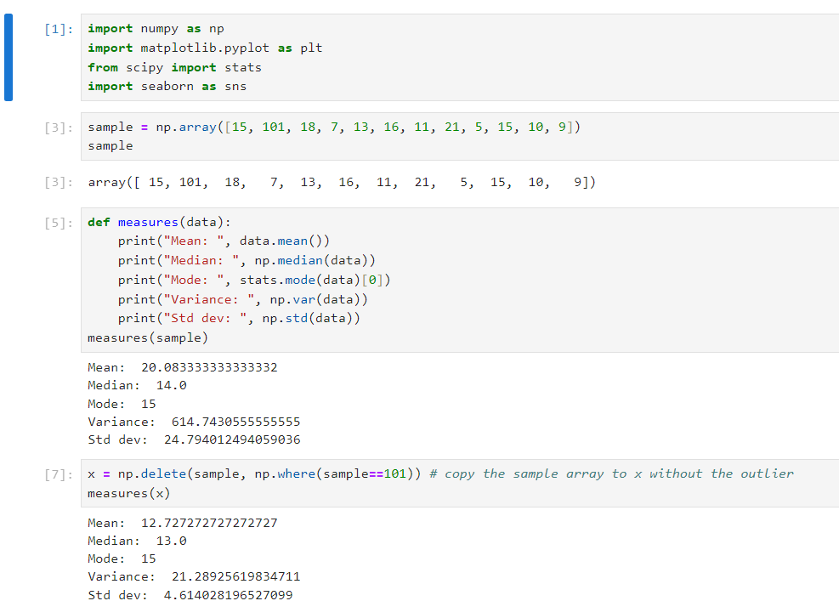
Module 1 implementation

Slide 12
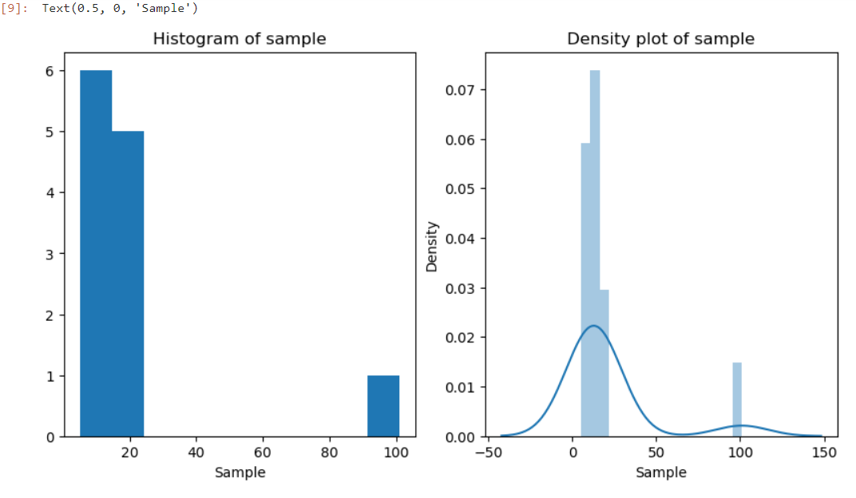
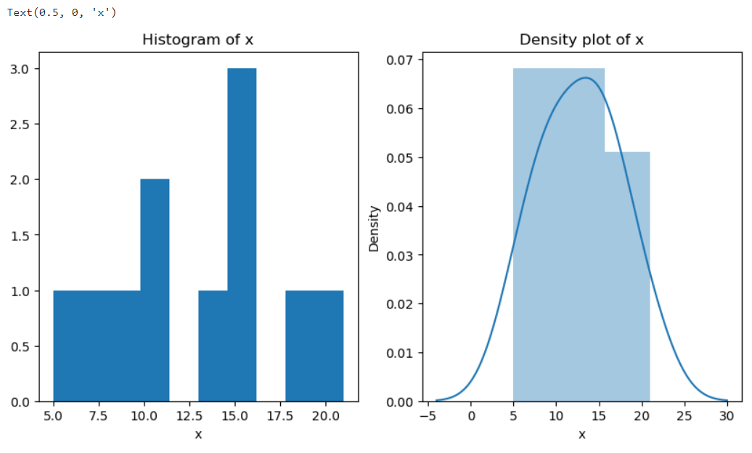
Module 1 output
Outlier with sample
Outlier with sample of x

Slide 13

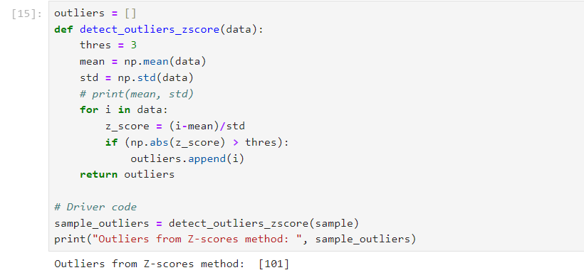
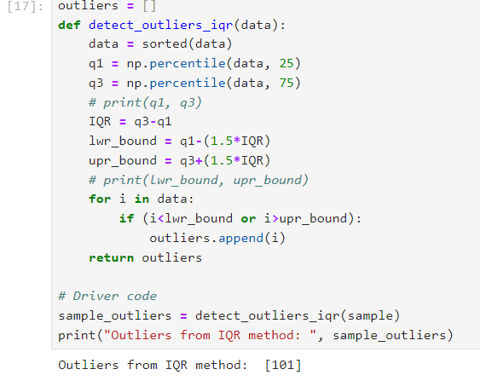
Module 1 output
Outlier detection using Z-Score
Outlier detection using IQR

Slide 14
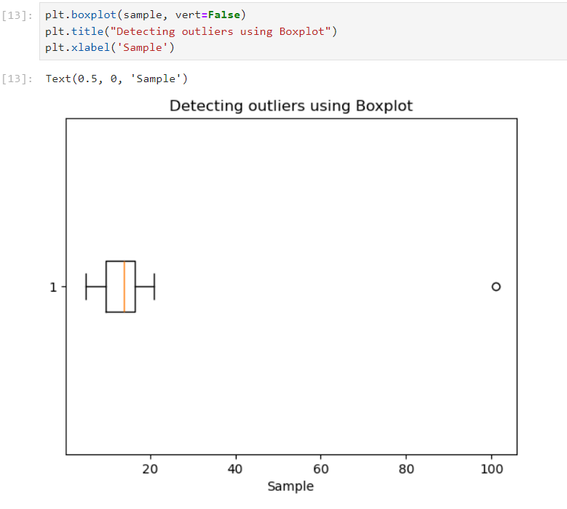
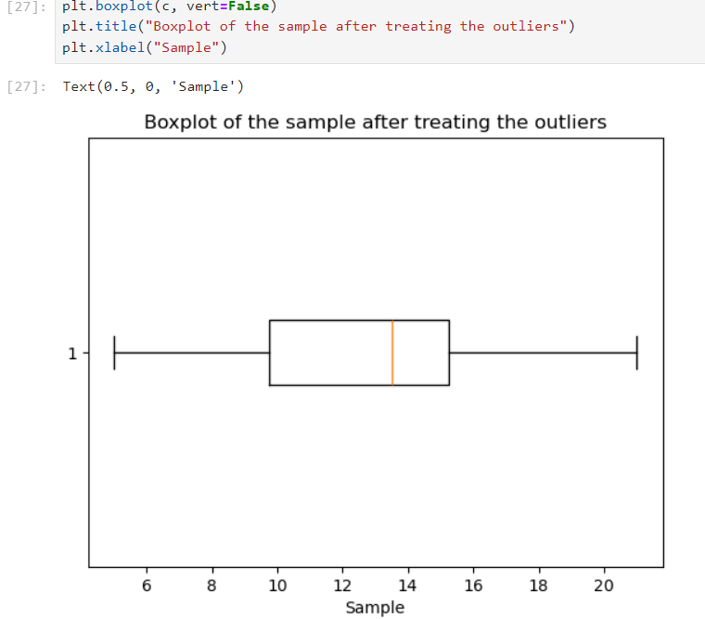
Module 1 output
Detecting outlier using boxplot
Boxplot after treating outlier

Slide 15
Module 2
In module 2,with the help of diabetics dataset ,first the library is imported,diabetic dataset is loaded and first 10 rows with all columns is displayed. After boxplot of bmi,original boxplot of bmi with outliers,boxplot of bmi without outliers is displayed.
Scatter plot with outlier between bodymass index of the people vs bp of the people is visualized. Scatter plot without outlier between bodymass index of the people vs bp of the people is visualized.
Age,length of the dataset i.e diabetics is shown with the help of numpy and pandas program using Z-Score method and the type of datatype is also displayed.
The original data frame and the dataframe after removing outlier program is used and output is verified.IQR value is calculated with the help of formula IQR=Q3-Q1.And upper bound and lower bound is also calculated.
Atlast outlier is detected and removed and the shape is displayed before and after removal of outlier.

Slide 16
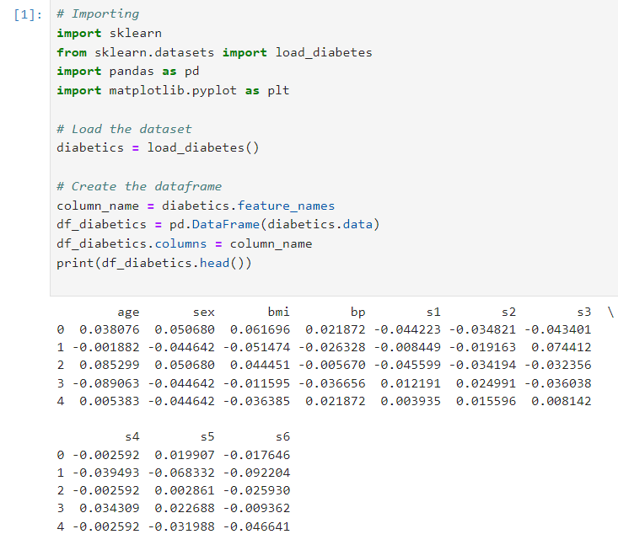
Module 2 implementation
First 10 rows of Dataset is loaded

Slide 17
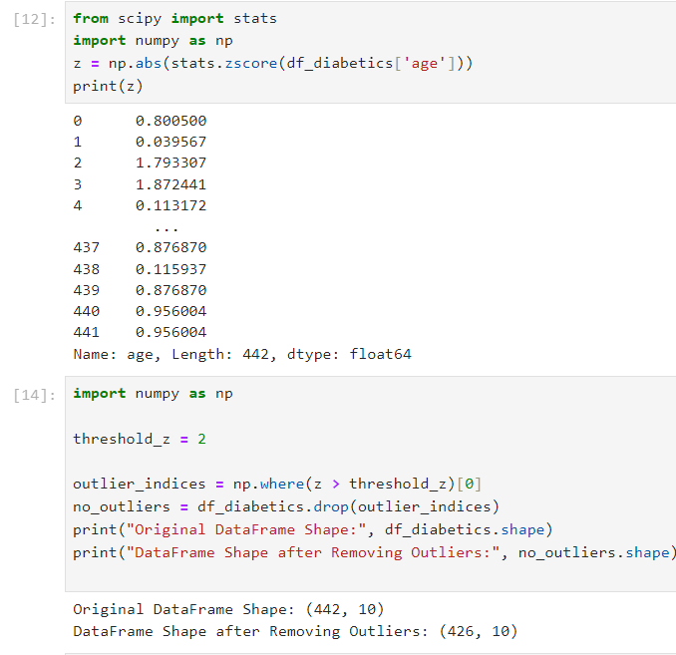
Module 2 output
The age,length ,datatype of datas is shown and the original value with outliers and the dataframe after removing outlier value is diaplayed.

Slide 18
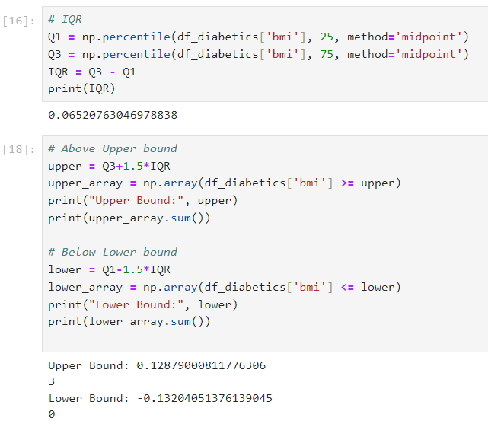
Module 2 output
Outlier is detected using IQR method and the IQR value ,Upper bound value,Lower bound value is displayed.

Slide 19
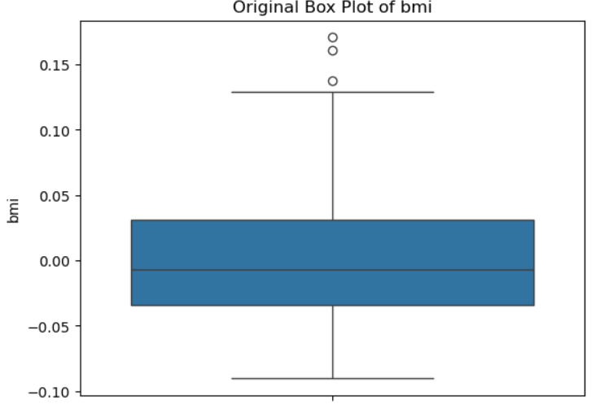
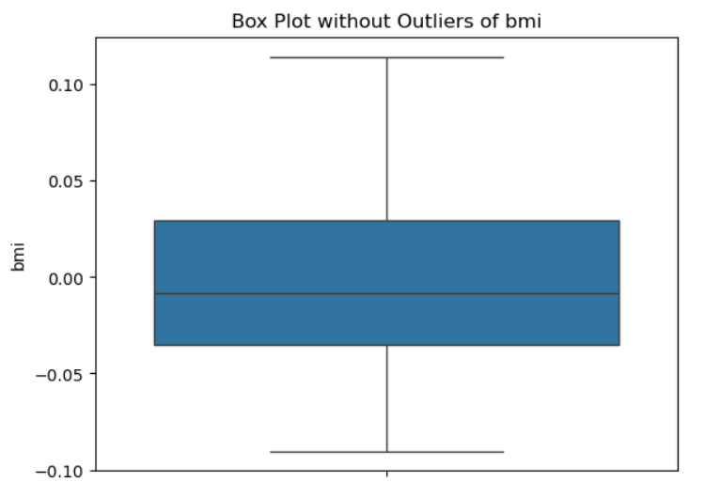
Module 2 output
Boxplot of BMI with outlier
Boxplot of BMI without outlier

Slide 20

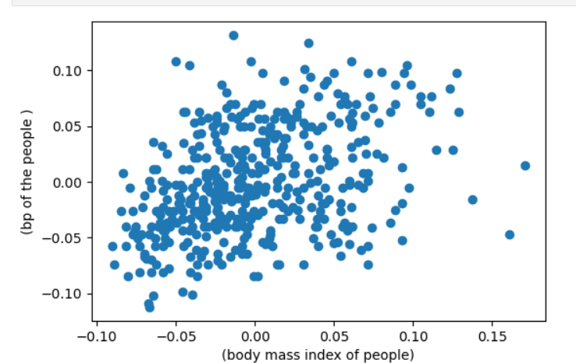
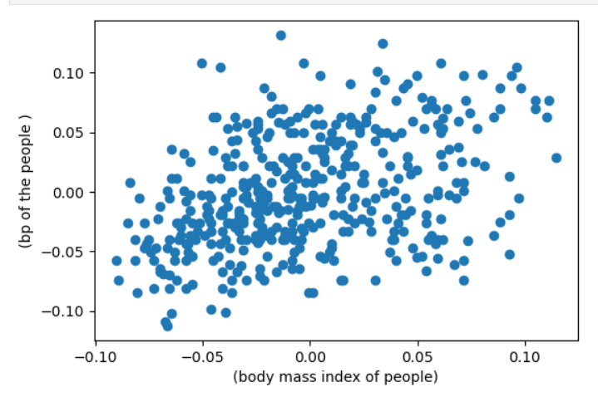
Module 2 output
Scatterplot btwn bodymass vs bp with outlier.
Scatterplot btwn bodymass vs bp without outlier.

Slide 21
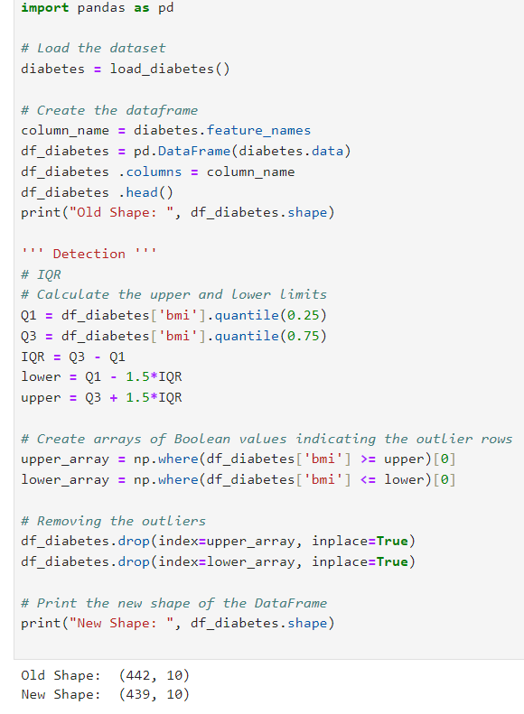
Module 2 output
Atlast after removing outlier which is there in diabetics dataset the old shape value and the new shape value is finally displayed.

Slide 22
Module 3
In this module with the help of iris dataset ,first the library is imported and the dataset is read and first 5 rows of dataset is displayed .Then with the help of shape(),info() function the shape of the dataset and info of the dataset is loaded.
Using drop duplicate function,duplicates are dropped and the values are displayed.types of species count is displayed using count values of function.
The graph between three different types of species vs count were displayed in the form of countplot using seaborn and matplot libraries.
Sepal length in cm vs sepal width in cm were graphicall represented in scatterplot.same petal length in cm vs petal width in cm were displayed using scatterplot.
Pair plot is made for all the three types of species like sepal length,sepal width,petal length,petal width in x –axis and petal length,petal width,sepal length,sepal width in y-axis is shown as pictorial form.
Using distplot 4 graphs is displayed .i.e the sepal length vs density,sepal width vs density,petal length vs density and petal width vs density.
Correlation matrix is displayed,heatmap of species were shown ,using box plot outliers present in all the species in both sepal and petal is identified and the outliers were removed and the actual size and value were changed and the graph without outlier were finally displayed.

Slide 23
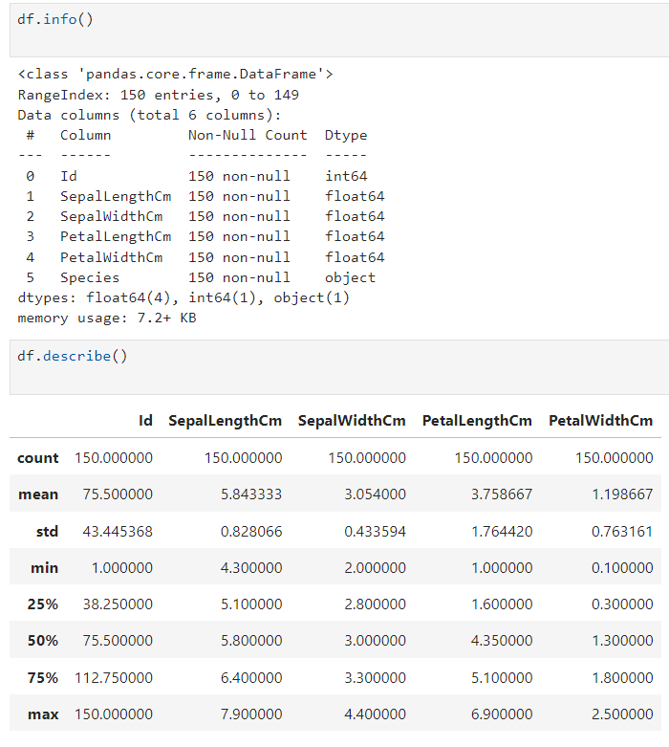
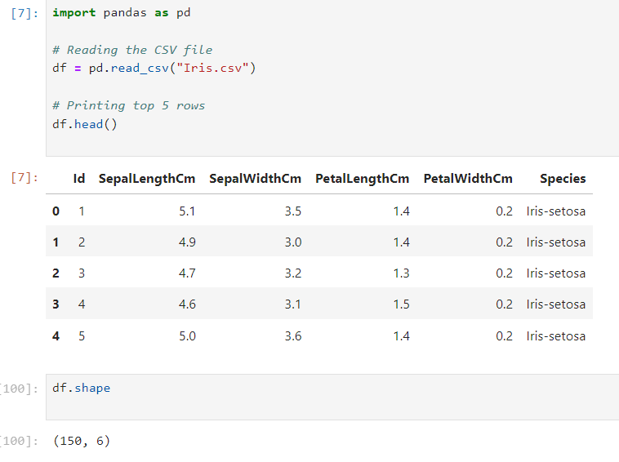
Module 3 implementation
Reading the iris dataset and df shape
Getting info and describe ()

Slide 24

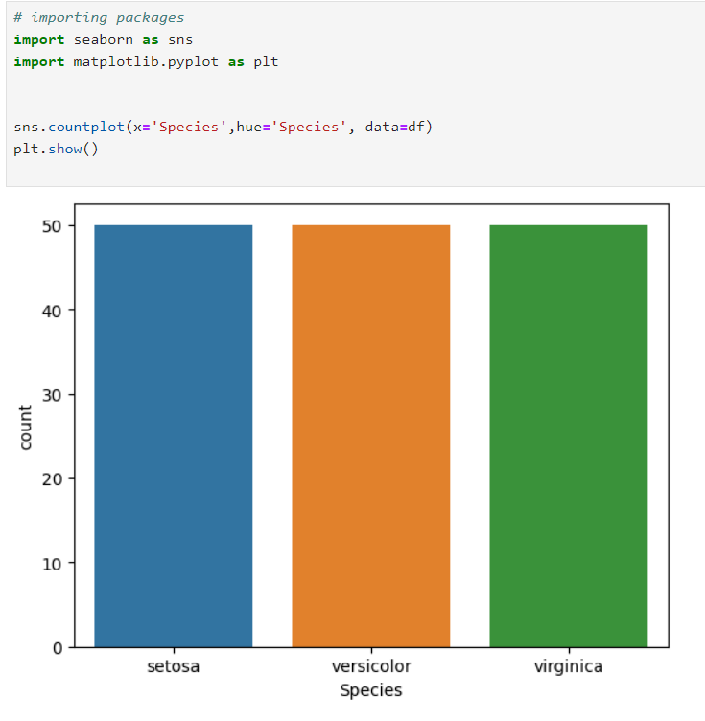
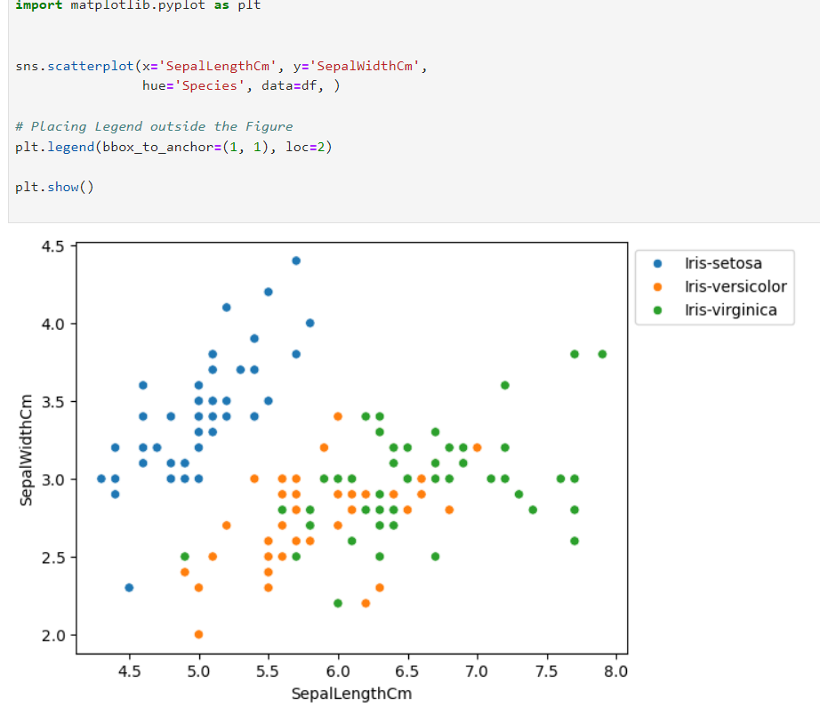
Module 3 implementation
Counting the species using countplot graph.
Sepal length vs sepal width using scatterplot .

Slide 25

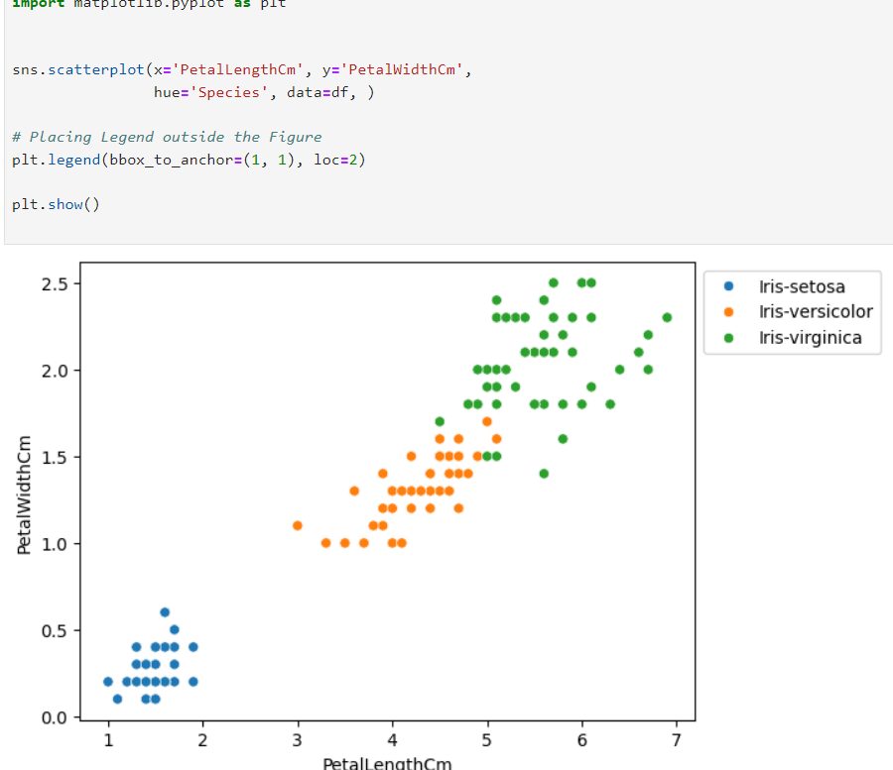
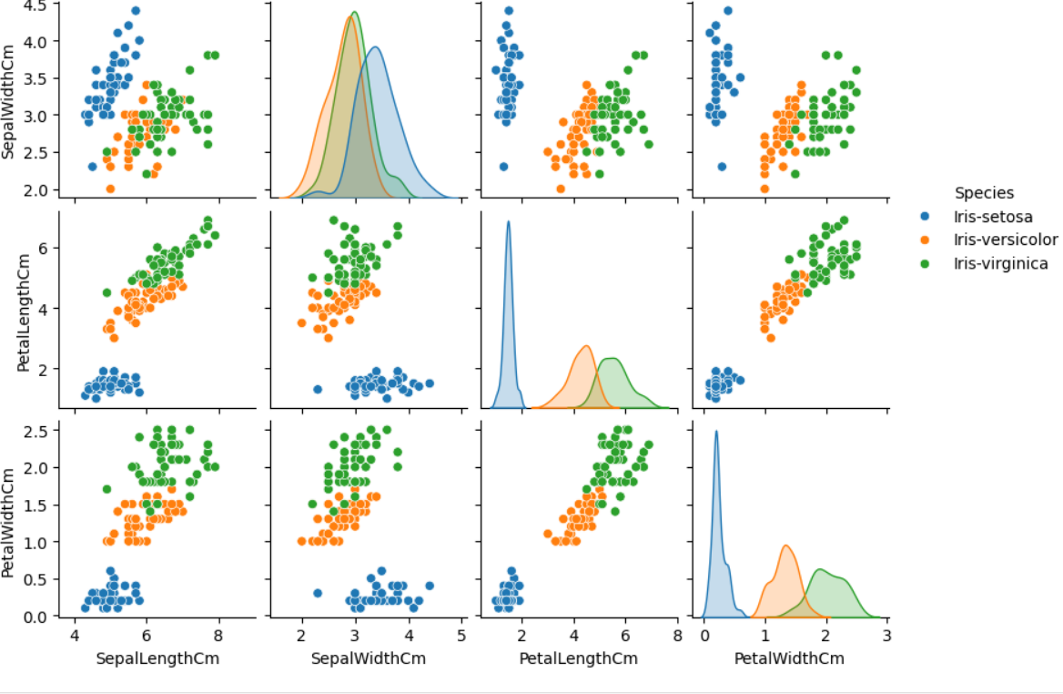
Module 3 output
Petal length vs petal width
All in one chart

Slide 26
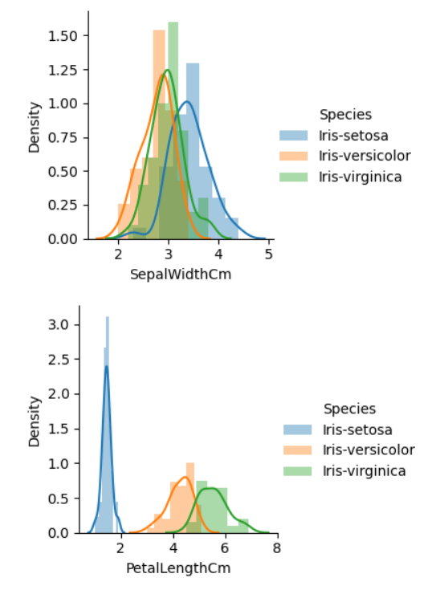
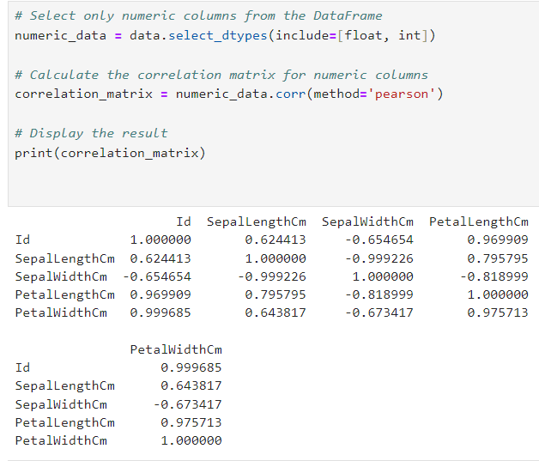
Module 3 output
Species vs density.
Displaying correlation matrix.

Slide 27
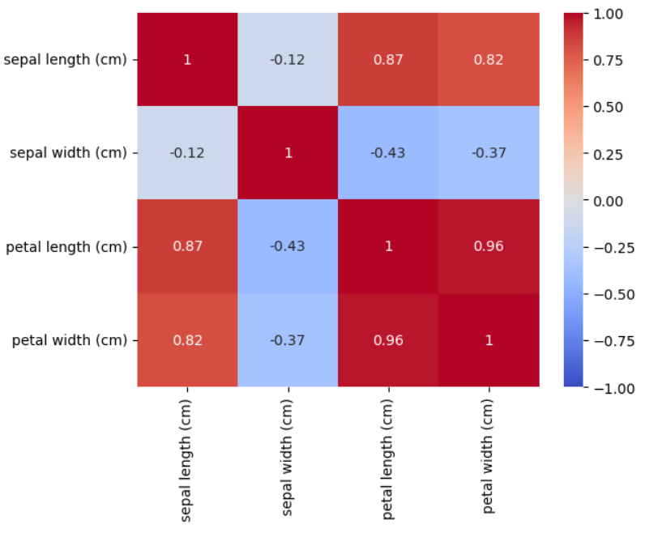
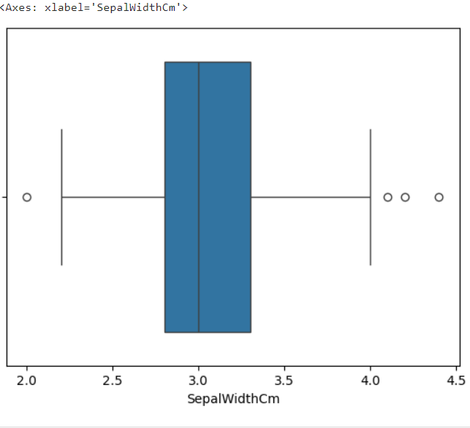
Module 3 output
Heat map
Outlier is detected

Slide 28
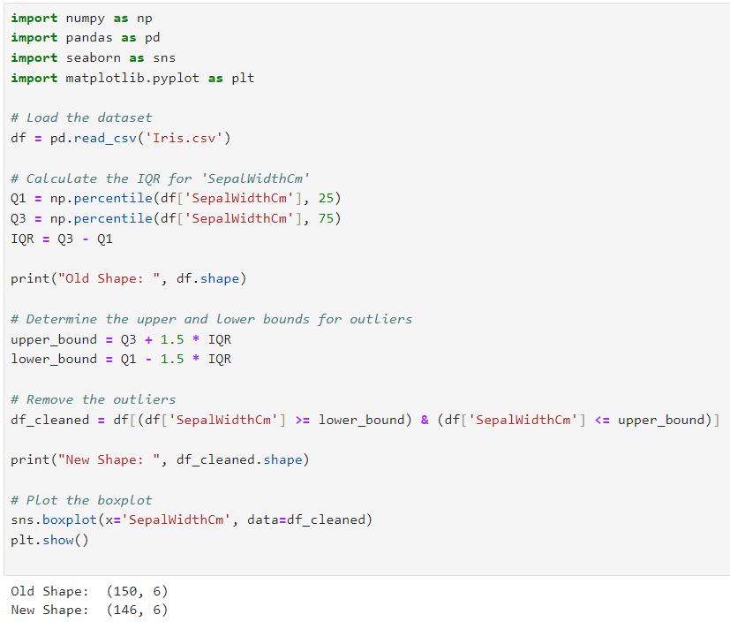
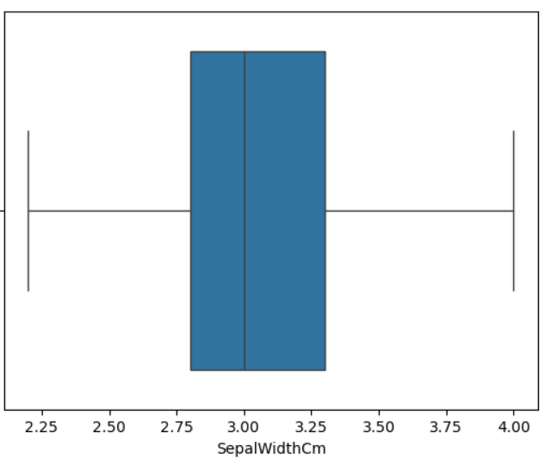
Module 3 output
The final output after removing outlier the shape is changed and the graph represent species without outlier.

Slide 29
Conclusion
Detecting outliers is a crucial step in data analysis, as it helps improve the accuracy of models and ensures data integrity. By following a structured execution plan, you can effectively identify and handle outliers in your dataset.
Key Takeaways:
Clarity of Objectives: Clearly define your goals to guide the entire process.
Thorough Preprocessing: Cleaning and normalizing your data is essential for accurate analysis.
Method Selection: Choose an appropriate outlier detection method based on the data type and distribution.
Evaluation and Reporting: Regularly evaluate the results and document your findings for transparency and future reference.
Iterative Improvement: The process should be dynamic, allowing for adjustments and refinements as you gather more insights.

Slide 30
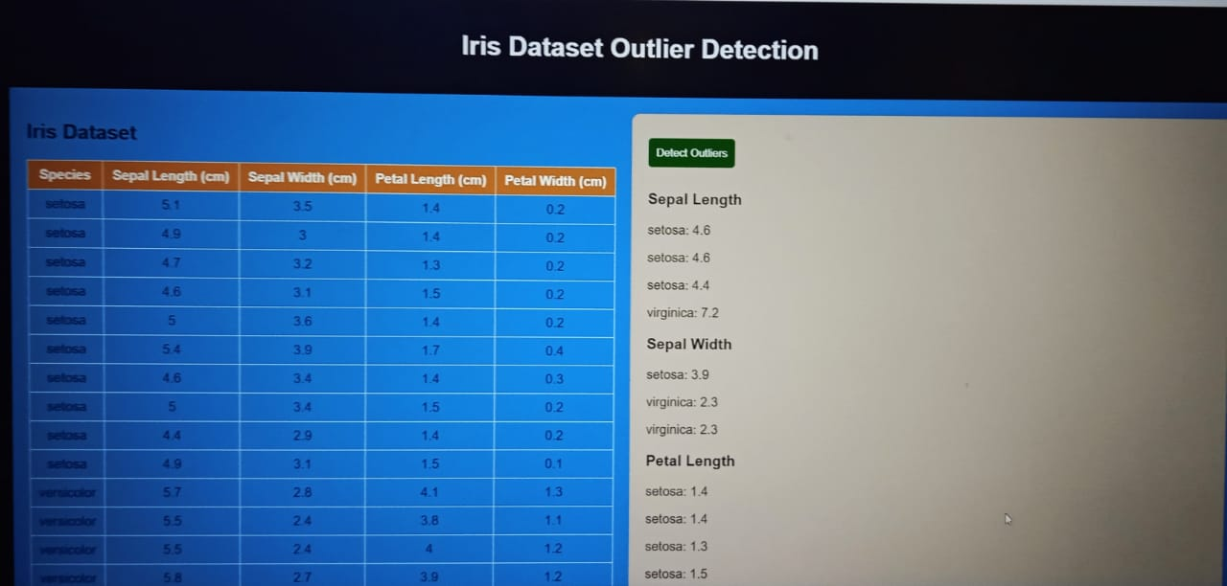
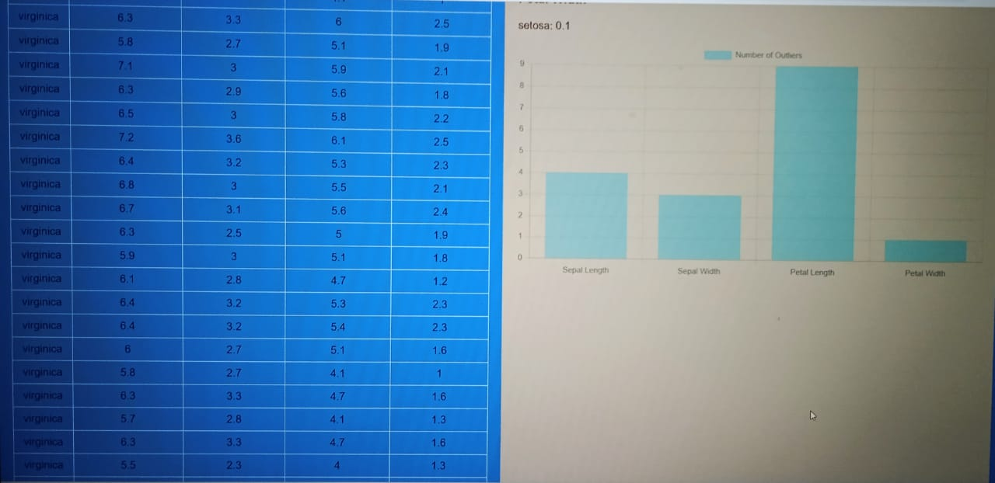
Module 4
In module 4 website is created to detect the outlier for first 50 datas from iris dataset .

Slide 31
Reference
Link of my own wesite
file:///C:/Users/boopa/Downloads/outlier%20detection/templete/index.html
detecting and treating outlier
outlier detection using diabetics data set
outlier detection using iris data set

